Slide 1



Slide 2




Slide 3



Slide 4



Slide 5




Slide 6



Slide 7
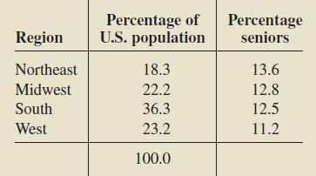
From the following data, determine the percentage of residents that are senior.

Slide 8


Slide 9

Bayes’s Rule

Slide 10


Slide 11


